Slide 1

The Service App
Group id: 29
2153053 Rajesh P. Prajapati
2153055 Hitesh H. Rajput
K.S. School of Business Management
Gujarat University, Navrangpura,Ahmedabad-380009.

Slide 2
COMPANY PROFILE
SERVICE
Name of Organization: OM ELECTRONIC SERVICES
Nr. satyam nagar bus stand, Nagarvel hanuman road, Amraiwadi, Ahmedabad-380026.
About Organization:
Om services is a small company which provides services for daily needs of home and office including electronics and watch, Since last more than 10 years.

Slide 3
EXISTING SYSTEM
Currently, there are lots of application which are providing services. Customer used to call for register service provider or went to the shop for registration. For this registration process of service provider customer lots of time is being consumed.
So we develop this application to change their schedule of registering service provider by calling or self-registration.
But with this app customers able to register service provider from their home and without waste of time they got services fast.

Slide 4
PROPOSED SYSTEM
Through our application the end user will be using the mentioned features that will help them in search for a Service Provider. As in the early era, all the search for a good Service provider was done manually which used consume a lot of time, it used to cost the end-user some expenses such as calling expenses, travelling expenses, and etc.
The system will provide platform on which user can easily take services online.

Slide 5
SCOPE OF SYSTEM
Scope of this project, This Android Apps User can able to get the services from this app to their home.
The key features that are provided by the application, such as:
Selection of service
The users will select service which they need.
Select service provider
After successfully selecting the service and the service provider nearby there location.
While user has to select service provider they can see the list of service provider who are the nearby location from users home.
User will be able to select the any service provider from this list and view the available offers given by the Service Provider, the reviews done by other users and the ratings of that particular Service Provider. Once that is done, the user then can book the Service Provider.
Giving Reviews and Ratings:
Once the service is done, the user can then give his/her Reviews and Ratings to that Service Provider.

Slide 6
OBJECTIVE OF SYSTEM
This system gives the facilities to search the services.
Use can be get services from this app to their home.
This system will help to be save a time of user.
System will be provide various types of the services Like Painter, Plumber, Electrician, Carpenter. User can be give Reviews and Rating to that service app.

Slide 7
STAKEHOLDER OF SYSTEM
User :-
->Login
->Registration
->Request For Service Provider (Painter, Plumber, Electrician, Carpenter)
->Reviews and Ratings
->Logout
Service Provider:-
->Feedback to the user
Admin :-
->Login
->Manage the database

Slide 8
PROJECT DEFINITION
We are developing an application through which users can request for the services to the Electrician, Plumber, Carpenter, Painter.

Slide 9
FEASIBILITY STUDY
TECHNICAL FEASIBILITY
System is feasible with the available resources (such as hardware and software) and technology in the software.
The technology is stable and resources (such as hardware and software) are easily available and also easily accessible.
This system is technically feasible.

Slide 10
OPERATIONAL FEASIBILITY
System will easily be operated without any special knowledge.
Thus the system is advantagable and satisfies all the user requirements. So the system is operationally feasible.
ECONOMICAL FEASIBILITY
No Special Hardware or Software is required to purchase for system development.
System will give long-term benefit to the owner. So the system is economically feasible.
User can select the service and can contact to the service provider free of cost through this app.

Slide 11
HARDWARE AND SOFTWARE REQUIREMENT
Hardware Requirement : - PC OR Laptop with minimum
8GB RAM and CORE i3 processor.
Software Requirement : - Android Studio, SQL Lite database.

Slide 12
GANTT CHART

Slide 13
WORK BREAKDOWN STRUCTURE
System
1
Project initialization
1.1
Project Charter
1.1.1
Project plan 1.1.2
Requirement Gathering
1.2
Project Scope
1.2.1
Establish User need
1.2.2
Functions
1.2.3
Behaviour
1.2.4
Analysis 1.3
Analyzing Requirement
1.3.1
Feasibility Study
1.3.2
Design
1.4
UML Diagrams
1.4.1
Database Design
1.4.2
Module Design
1.4.3
Coding
1.5
Front End Design
1.4.4
Front End Coding
1.5.1
Back End Coding
1.5.2
Testing 1.6
Maintainance 1.7
Black box Testing 1.6.1
White box Testing 1.6.2
Unit Testing 1.6.3
System Testing 1.6.4
Documentation 1.7.1
User Testing 1.7.2

Slide 14
UML (UNIFIED MODELING LANGUAGE)

Slide 15
USECASE DIAGRAM
The Service App

Slide 16
ACTIVITY DIAGRAM

Slide 17
SEQUENCE DIAGRAM
(USER-REGISTRATION):

Slide 18
(USER-LOGIN):

Slide 19
CLASS DIAGRAM

Slide 20
SWIMLANE DIAGRAM

Slide 21
SYSTEM FLOW DIAGRAM

Slide 22
DATA DICTIONARY
Table No. | Table name
1 | Customer Table

Slide 23
Table Name (1): Customer Table
Description:-Store information about the customer.
Field Name | Data Type | Size | Constraint | Description
Cust_id | Varchar | 10 | Primary key | Stores customer id
Cust_fname | Text |  | Not null | Stores customer first name
Cust_lname | Text |  | Not null | Stores last name of the customer
Username | Varchar | 20 | Not null | Username of customer
Password | Varchar2 | 20 | Not null | Stores password of customer
Email | Varchar | 50 | Not null | Stores email address of customer
Contact_no | Number | 10 | Not null | Stores customer contact number

Slide 24
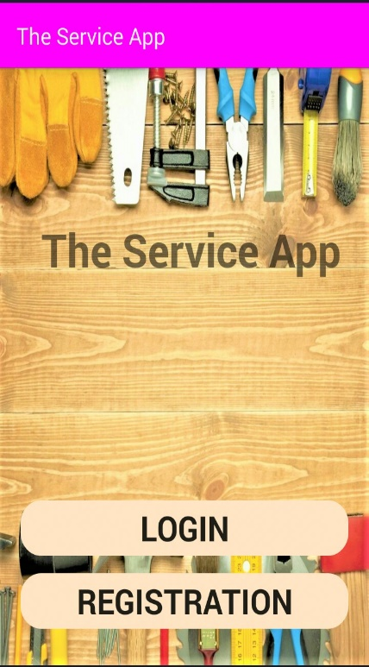
Input / Output Design
First Page

Slide 25
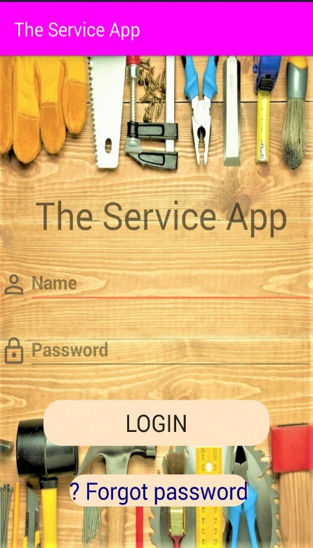
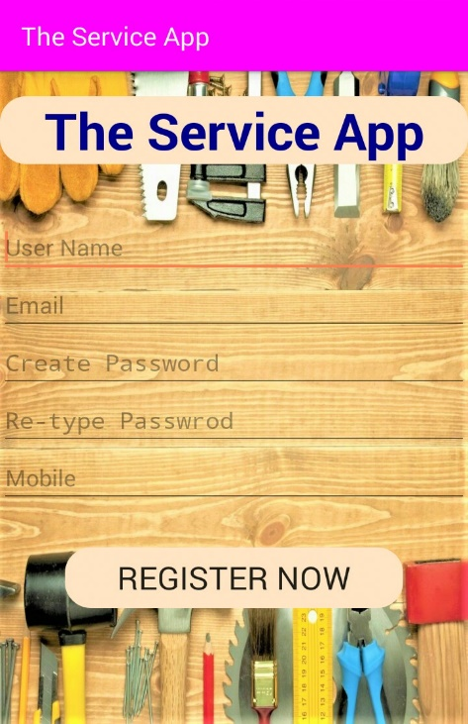
Login page
Registration page

Slide 26
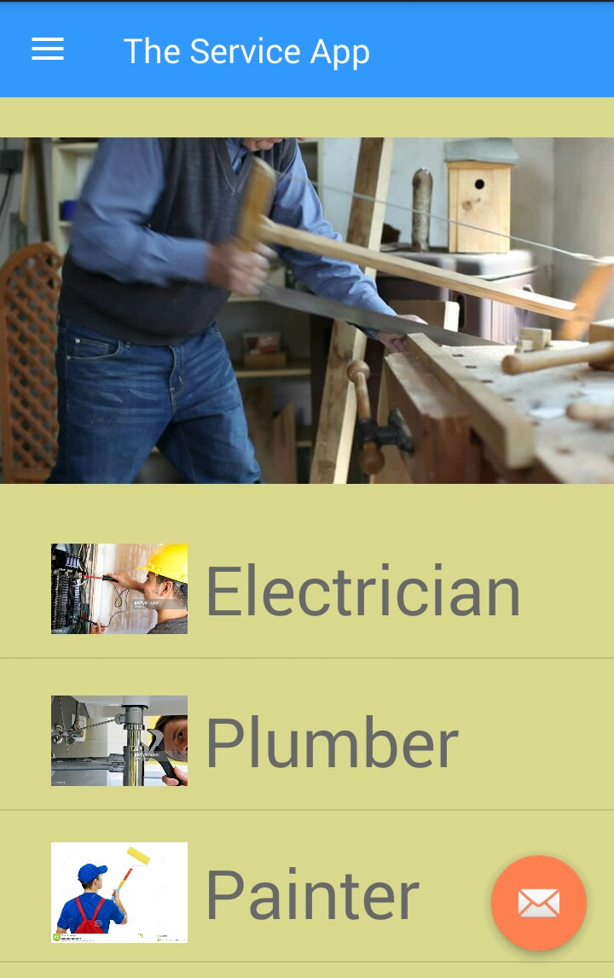
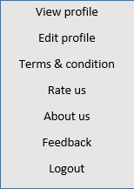
Home Page

Slide 27
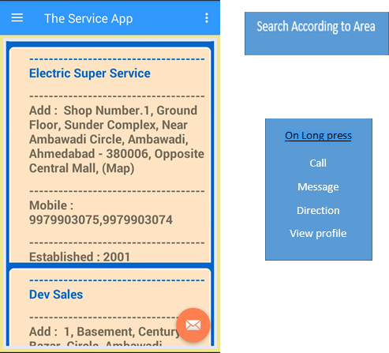
Service provider List

Slide 28
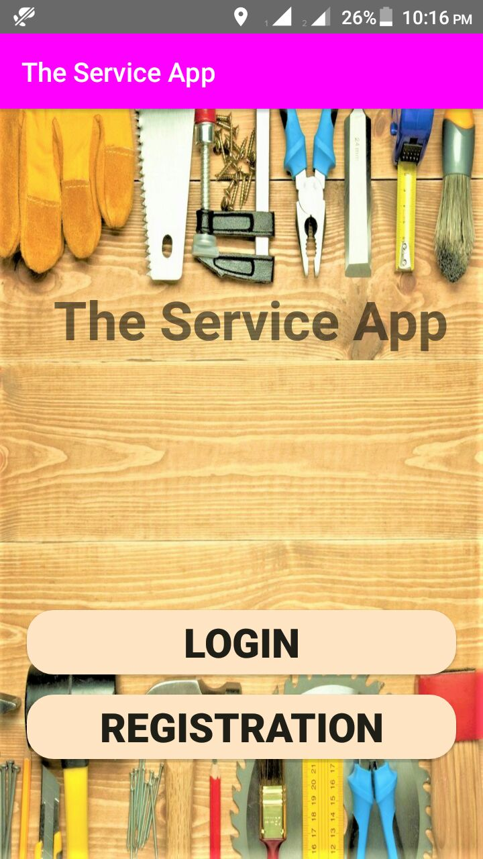
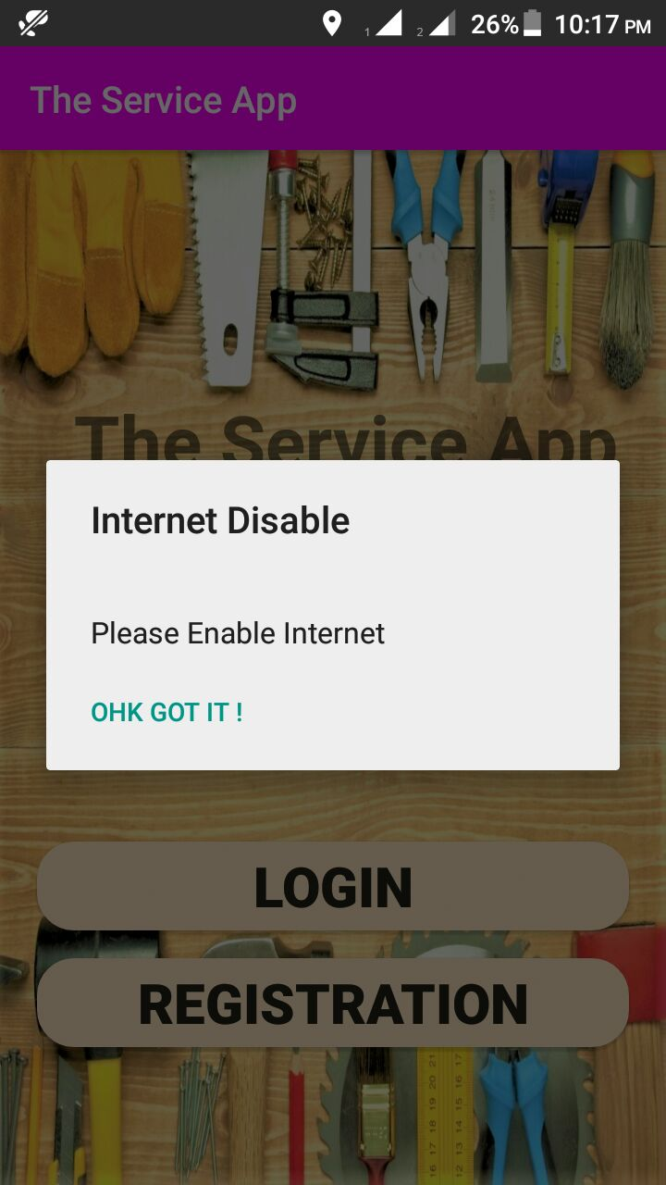
Testing
Internet Permission

Slide 29
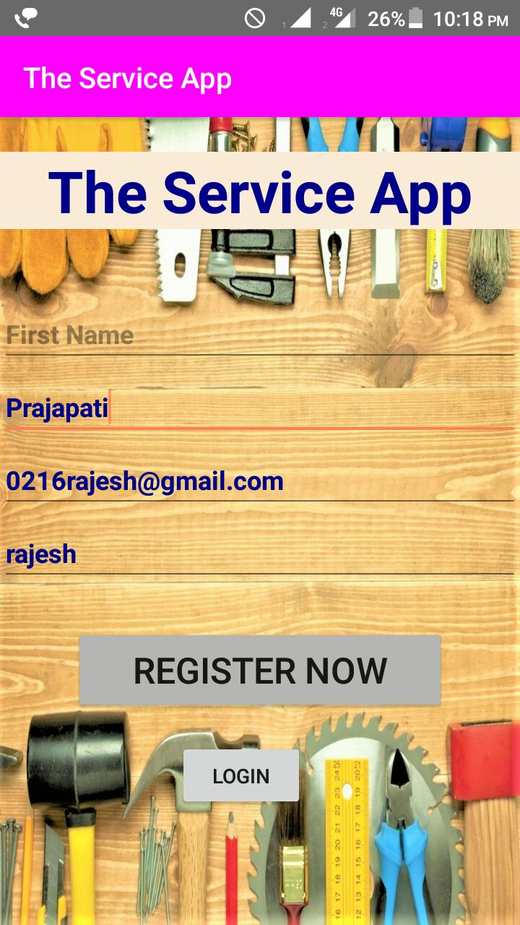
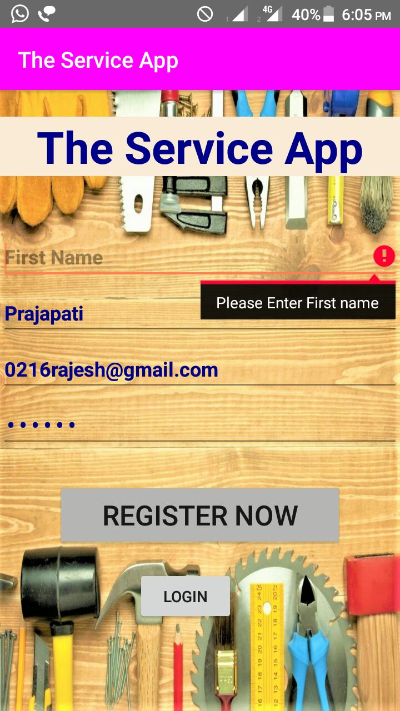
First Name

Slide 30
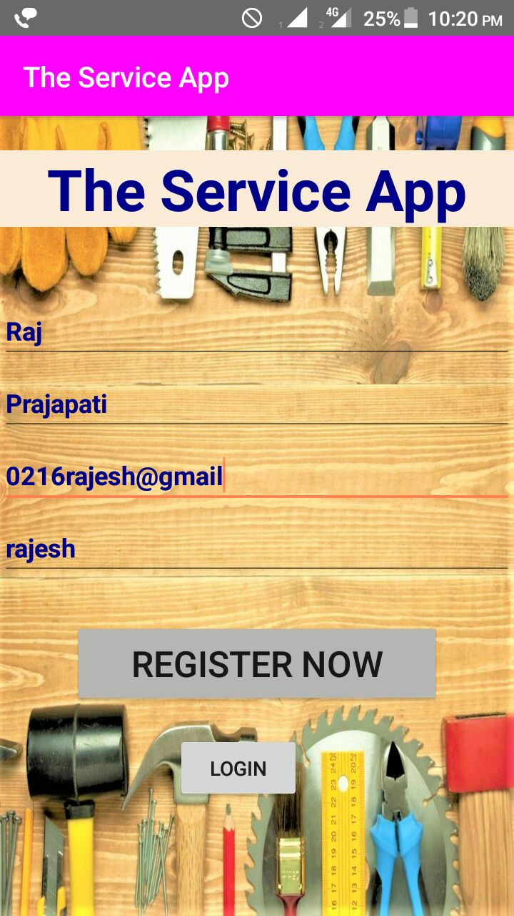
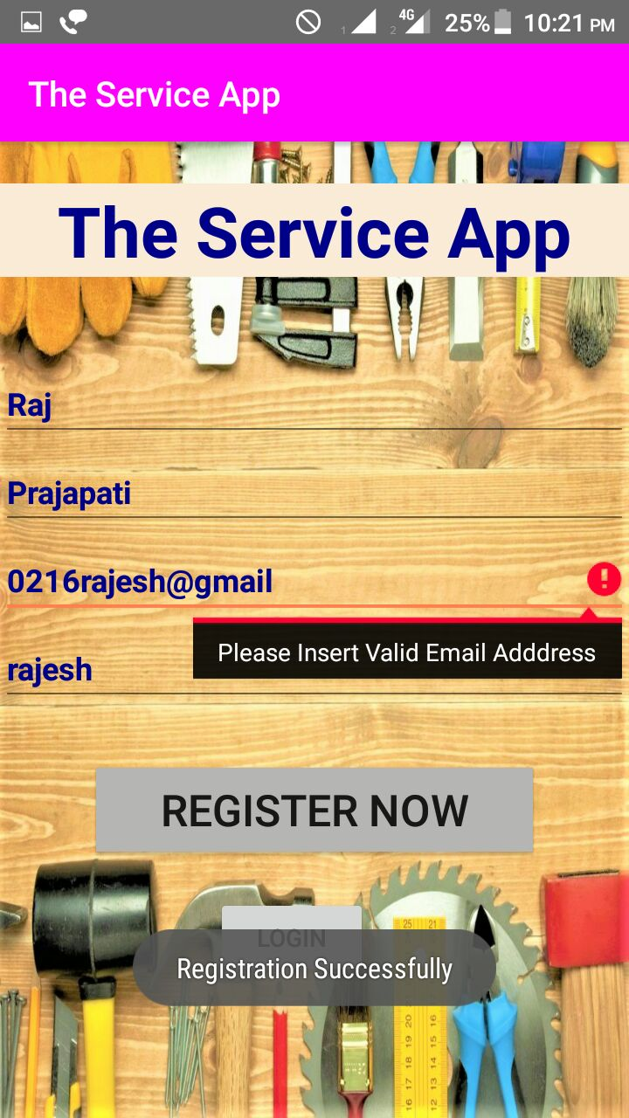
Email

Slide 31

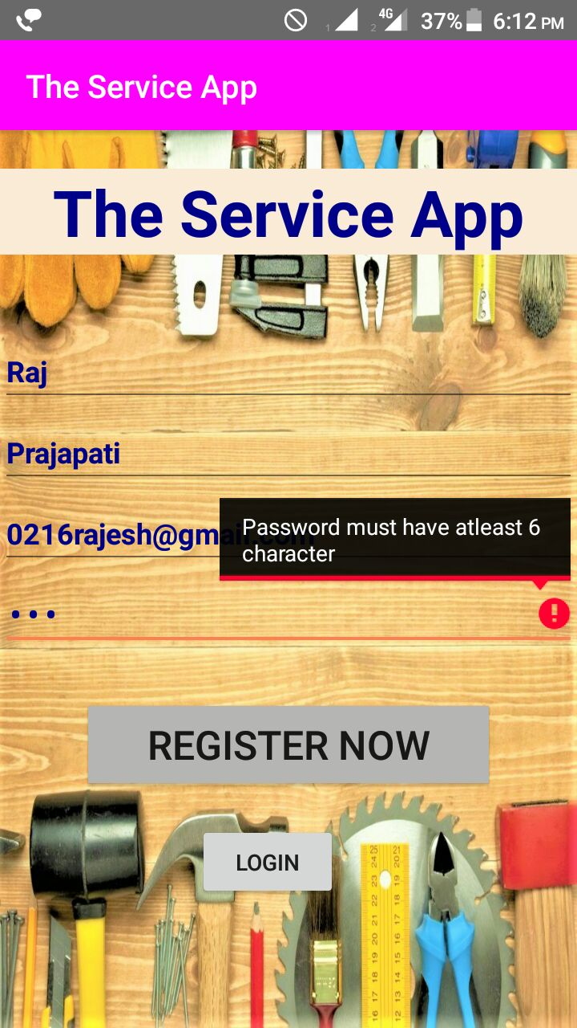
Password

Slide 32
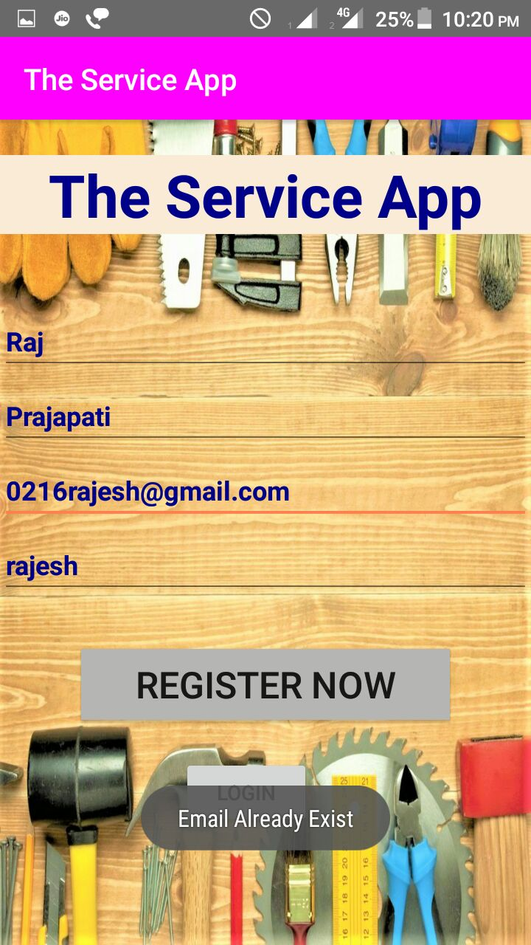
Email Already Exist

Slide 33
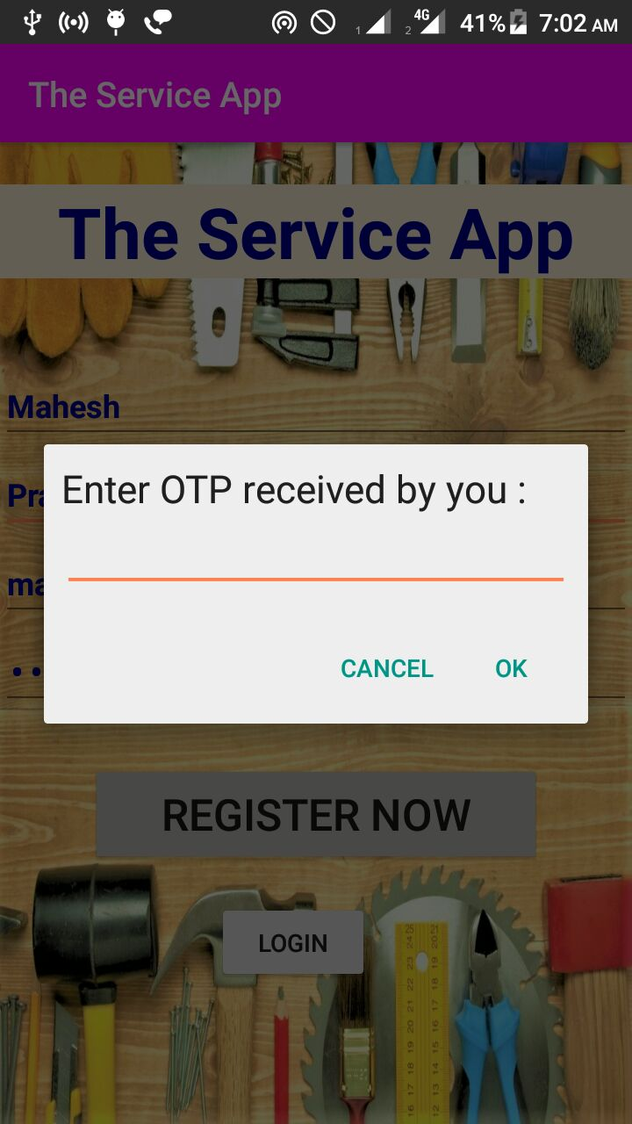
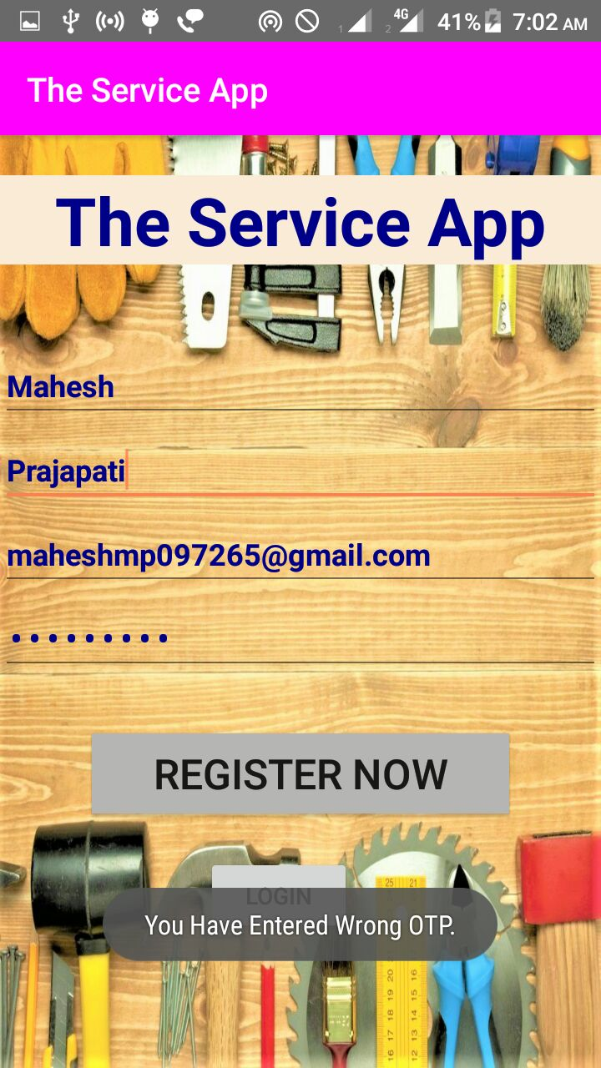

Slide 34
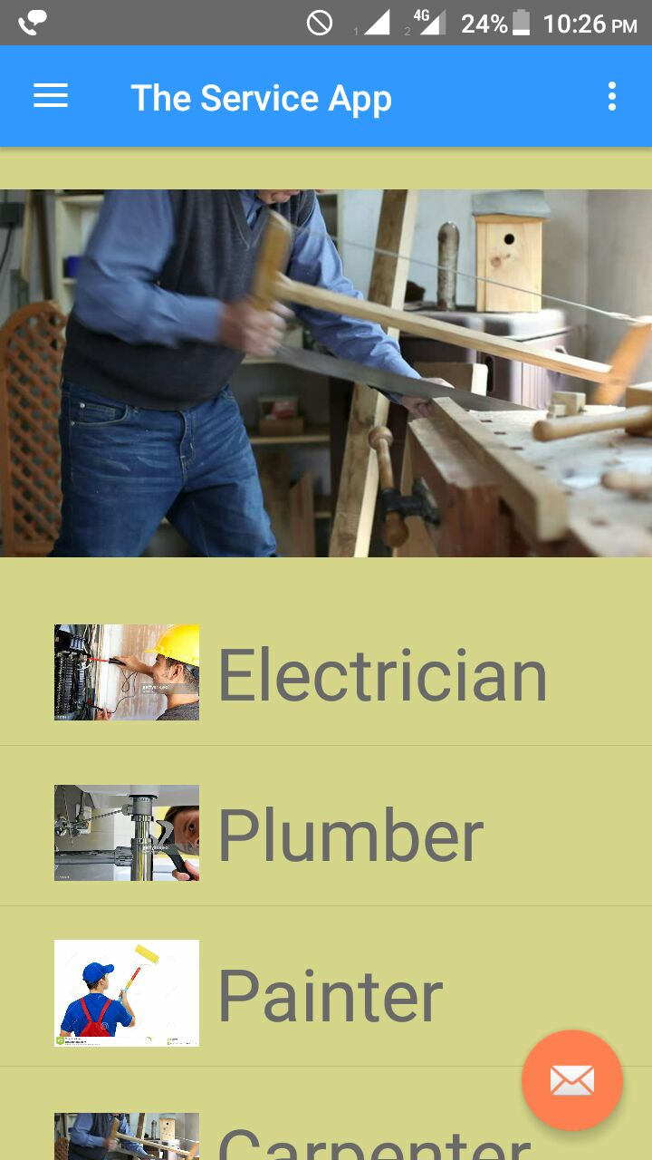
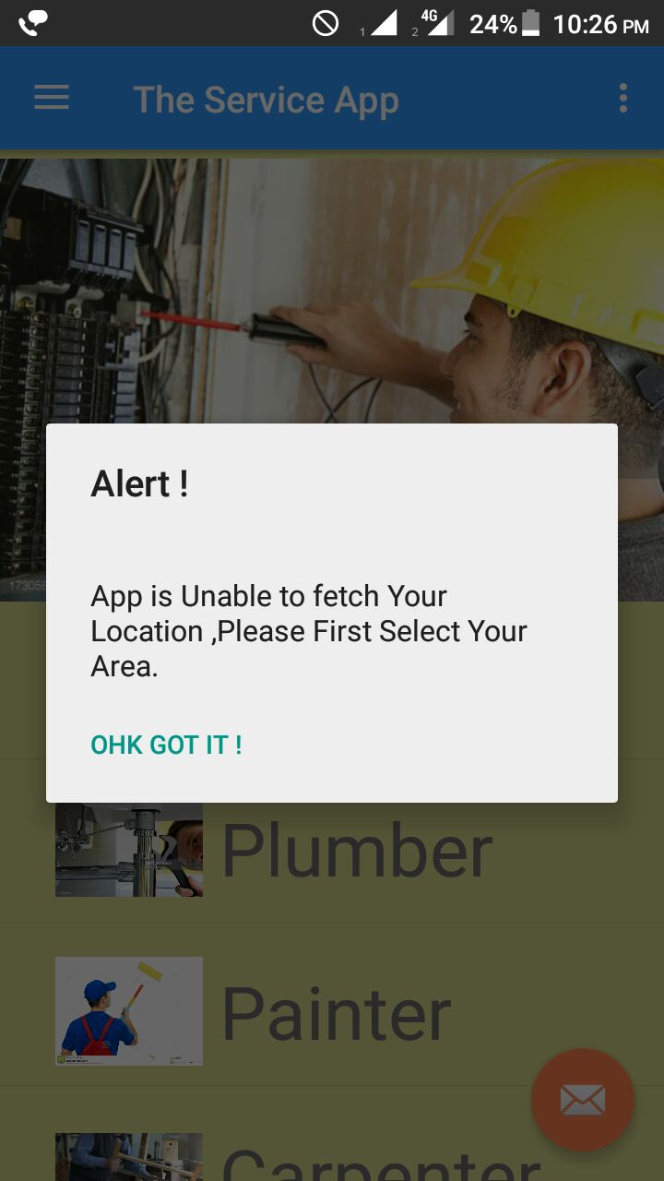
Location

Slide 35
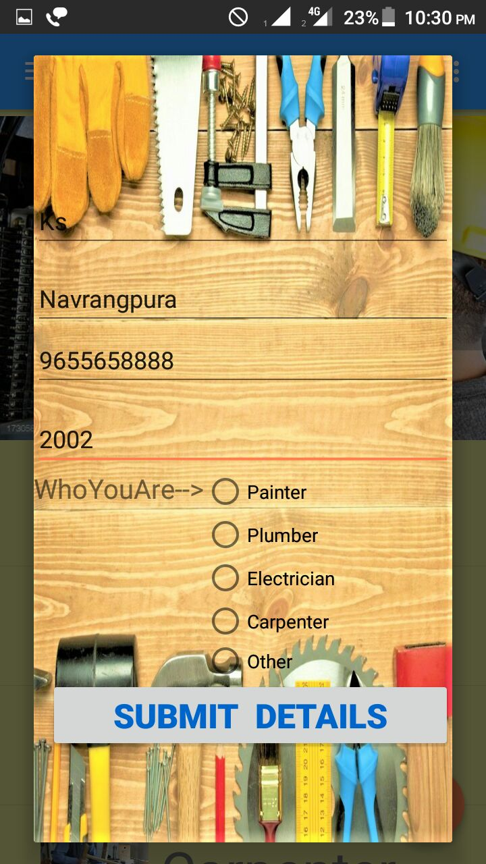
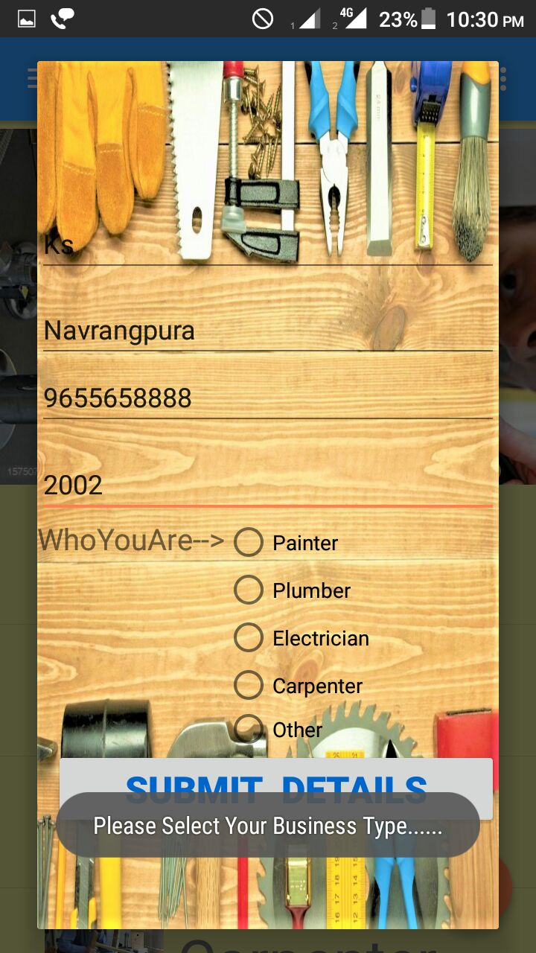
Business Type

Slide 36
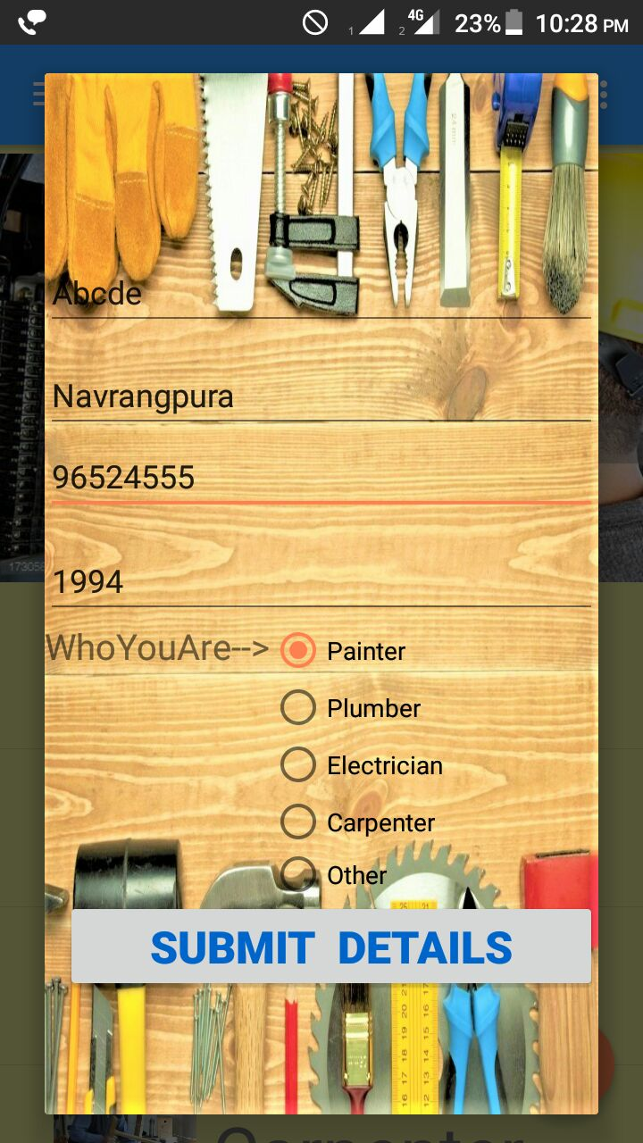
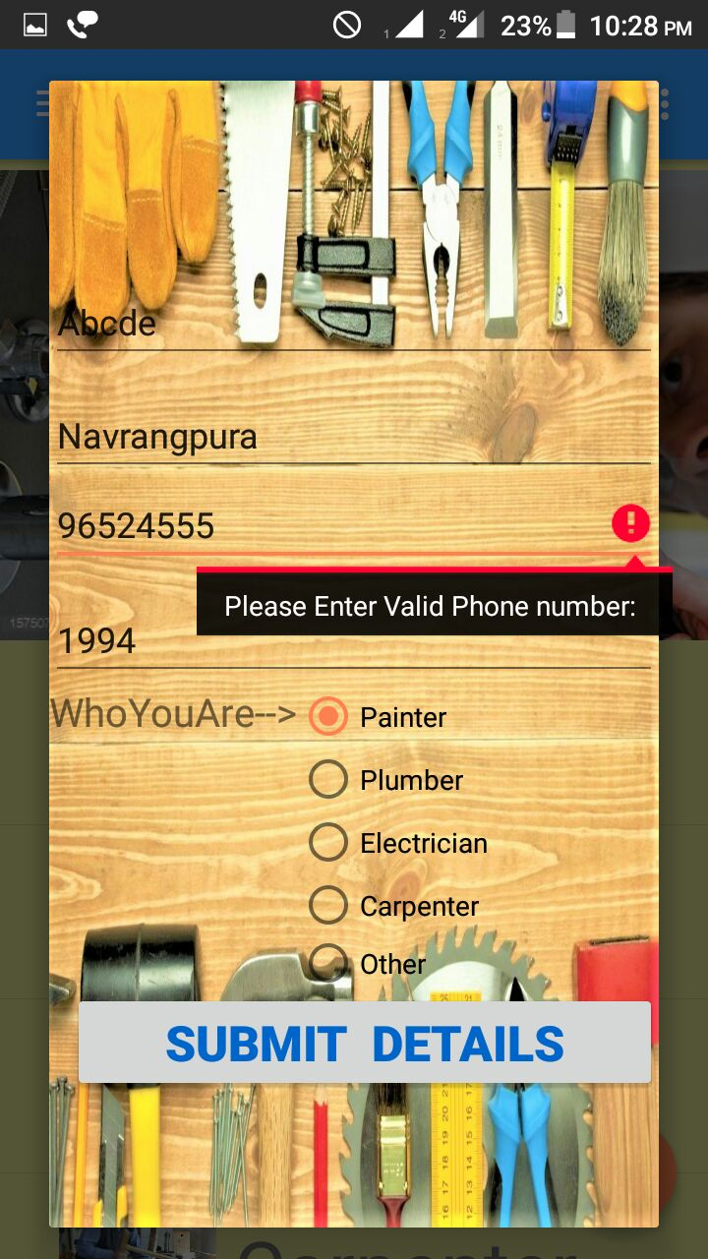
Mobile Number

Slide 37
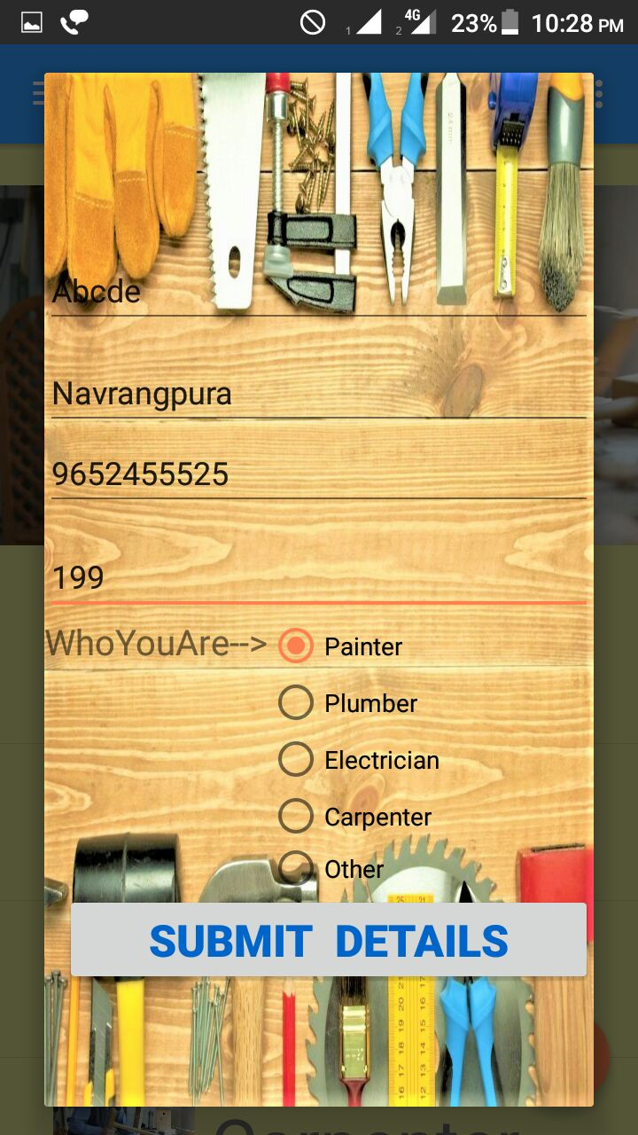
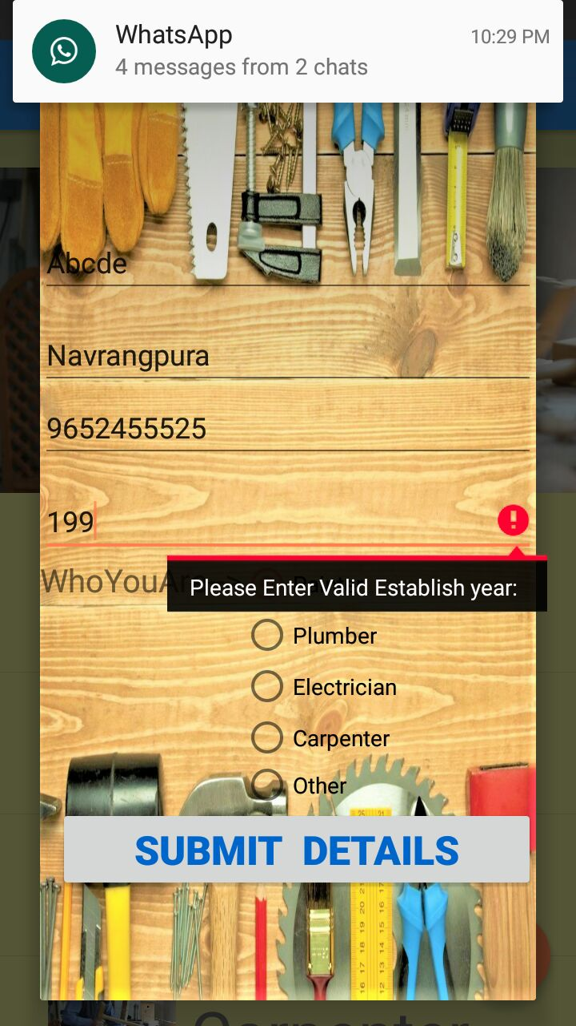
Established Year

Slide 38
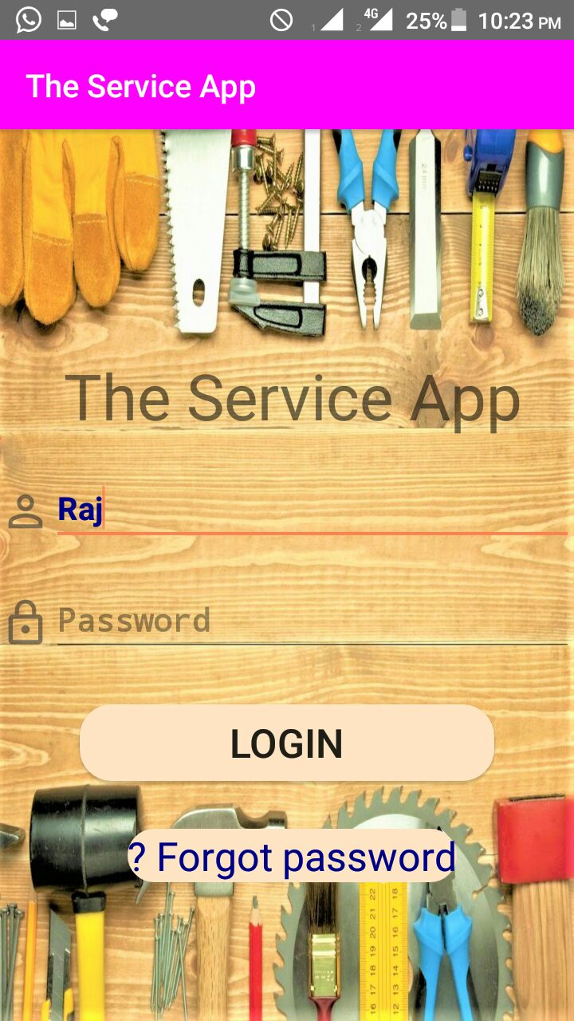
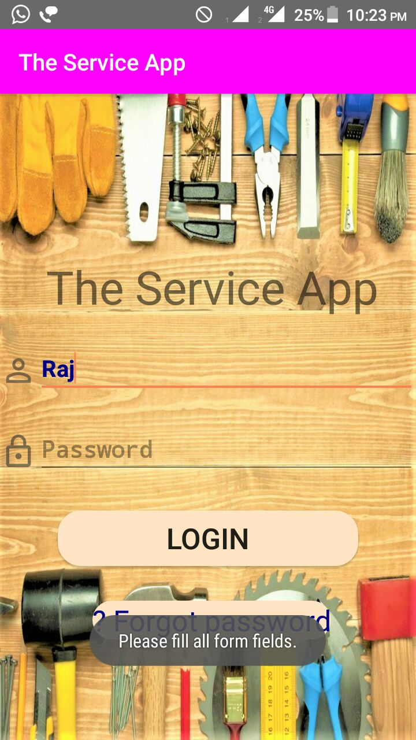
Fill Field

Slide 39
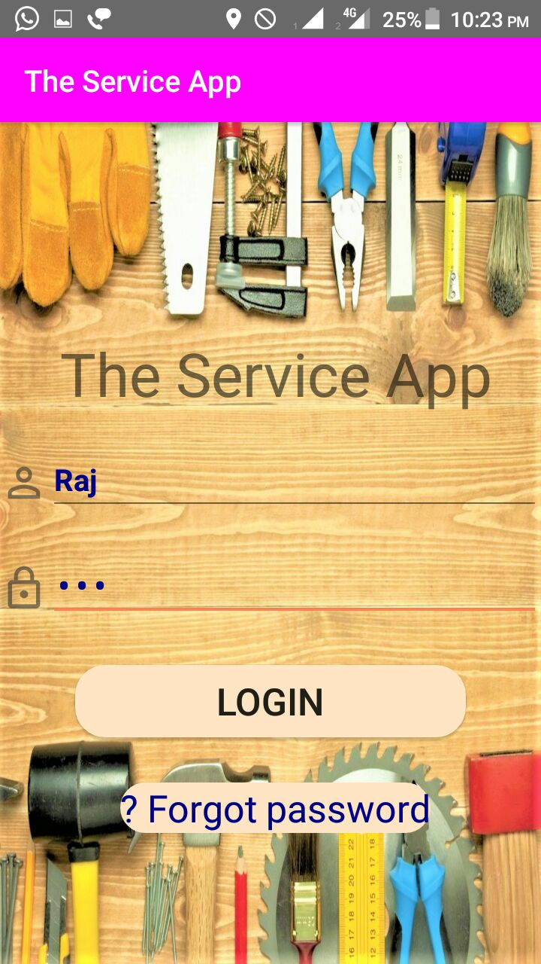
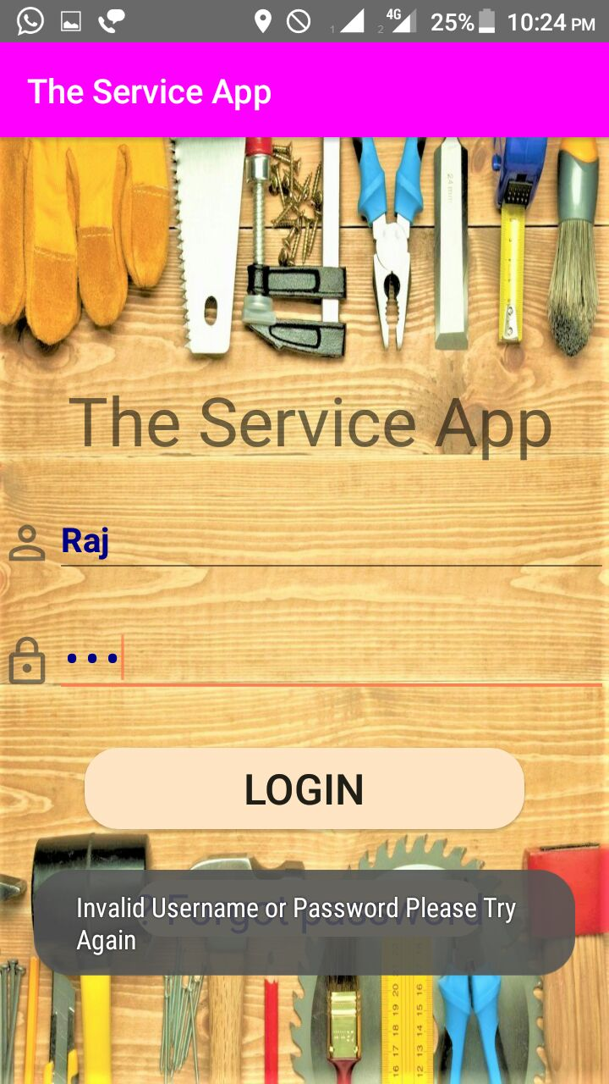
Invalid Uname & Password

Slide 40
LIMITATION
This application is all about to just provider a reference, the application does not take guarantee for the service provider.
The application does not provide online payment option.

Slide 41
FUTURE SCOPE
In the future, we can add the online payment option in the application.
In the future, we can add more services in the application Like Computer accessories, Appliances Repair.
To make the app more user friendly, We can provide two or more languages in the application.

Slide 42
BIBLIOGRAPHY
Books:
Analysis & Design of Information
By James A Senn
2. SOFTWARE ENGINEERING A practitioners’s Approach
By Roger S. Pressman
Web sources that were used for the project are:
www.developer.android.com
www.stakeoverflow.com
www.androidhive.com
www.w3schools.com

